Slide 1
Constructing Inverse Probability Weights for Dynamic Interventions
When to Start Antiretroviral Therapy
CIMPOD 2017
Lauren Cain
Principal Statistician, Takeda Pharmaceuticals
Visiting Scientist, Harvard T.H. Chan School of Public Health

Slide 2
Outline for today
Introduction to the Case-Study
Guided Exercises with Example Data
(Using SAS)
Q&A

Slide 3
1. Introduction to the
Case-Study

Slide 4
Motivating question
What is the optimal CD4 cell count at which to initiate cART (combined antiretroviral therapy)?

Slide 5
Clinical guidelines
At the time, clinical guidelines recommended initiating cART the first time CD4 cell count drops below…
  350 cells/mm³ (EACS 2009)
  500 cells/mm³ (DHHS 2009)
Examples of dynamic treatment strategies

Slide 6
Treatment strategies
Static (non-dynamic) strategies:
  do not depend on time dependent covariates
Dynamic strategies:
  depend on time dependent covariates

Slide 7
Examples of strategies:
Initiate cART…
Static strategies
  …at first visit
  …after 3 months
Rarely used in clinical practice
Most RCTs
Non optimal strategies
Dynamic strategies
  …when CD4<500
  …when CD4<200
Most common in clinical practice
Rarely RCTs
Optimal strategy
is dynamic

Slide 8
Examples of strategies:
Initiate cART…
…after 3 months
Strategy assigned at baseline
…when CD4<500
Strategy assigned at baseline
id | month | CD4 | cART
1 | 0
1 | 1
1 | 2
1 | 3
1 | 4
1 | 5
1 | 6
id | month | CD4 | cART
1 | 0
1 | 1
1 | 2
1 | 3
1 | 4
1 | 5
1 | 6

Slide 9
Examples of strategies:
Initiate cART…
…after 3 months
Strategy assigned at baseline
Treatment given known at baseline
…when CD4<500
Strategy assigned at baseline
Treatment given not known at baseline
id | month | CD4 | cART
1 | 0 | ? | 0
1 | 1 | ? | 0
1 | 2 | ? | 0
1 | 3 | ? | 1
1 | 4 | ? | 1
1 | 5 | ? | 1
1 | 6 | ? | 1
id | month | CD4 | cART
1 | 0 | ? | ?
1 | 1 | ? | ?
1 | 2 | ? | ?
1 | 3 | ? | ?
1 | 4 | ? | ?
1 | 5 | ? | ?
1 | 6 | ? | ?

Slide 10
Examples of strategies:
Initiate cART…
…after 3 months
Strategy assigned at baseline
Treatment given known at baseline
Treatment does not depend
on time-varying CD4
…when CD4<500
Strategy assigned at baseline
Treatment given not known at baseline
Treatment depends on time-varying CD4
id | month | CD4 | cART
1 | 0 | 600 | 0
1 | 1 | 580 | 0
1 | 2 | 560 | 0
1 | 3 | 540 | 1
1 | 4 | 520 | 1
1 | 5 | 500 | 1
1 | 6 | 480 | 1
id | month | CD4 | cART
1 | 0 | 600 | 0
1 | 1 | 580 | 0
1 | 2 | 560 | 0
1 | 3 | 540 | 0
1 | 4 | 520 | 0
1 | 5 | 500 | 0
1 | 6 | 480 | 1

Slide 11
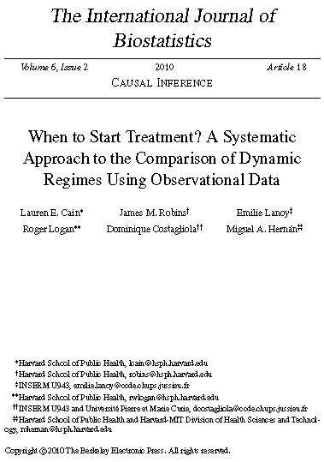
Methods Paper
  Subset of HIV-CAUSAL Collaboration
  How to use IPW to compare dynamic strategies with grace periods

Slide 12
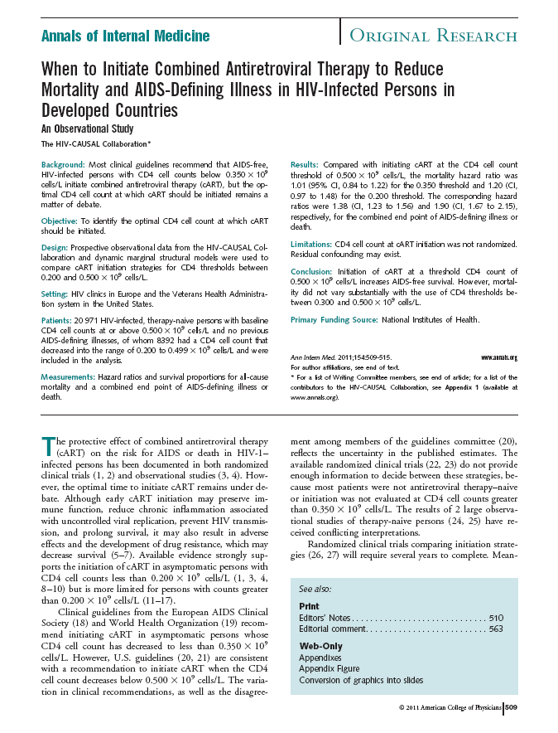
Clinical paper
  Complete HIV-CAUSAL Collaboration
  (at the time)
  Used inverse probability weighting methods to compare dynamic strategies
  AIDS or death:
  500 better than 450
  Death alone:
  similar for 300-500

Slide 13
The HIV-CAUSAL Collaboration:
Contributing cohorts
France: FHDH, PRIMO, SEROCO
Spain: PISCIS, CoRIS, CoRIS MD, GEMES
UK: UK CHIC, UK Register of Seroconverters
Netherlands: ATHENA
Switzerland: SHCS
United States: VACS-VC
Greece: AMACS
Canada: South Alberta HIV Cohort
Brazil: IPEC

Slide 14
The HIV-CAUSAL Collaboration:
Sample Size
After initial exclusions…
  ~70,000 individuals
  ~3 million person-months
  ~40,000 initiate cART during follow-up
  ~2,800 deaths
  ~6,400 AIDS-defining illnesses or deaths

Slide 15
The HIV-CAUSAL Collaboration: Baseline covariates
Sex
Age
Race (white, black, other or unknown)
Geographic origin (Western developed countries, other or unknown)
Mode of transmission (heterosexual, homosexual/bisexual, injection drug use, other or unknown)
CD4 cell count
HIV-1 RNA
Calendar year
Years since HIV diagnosis
Cohort

Slide 16
The HIV-CAUSAL Collaboration:
Time-varying covariates
CD4 cell count
HIV-1 RNA
Time since last laboratory measurement
AIDS-defining illness (when outcome is death)

Slide 17
Finding the optimal strategy:
Compare 31 strategies
“Initiate cART within m months after the recorded CD4 first drops below x cells/mm³”
  x takes the values 200 to 500
  in increments of 10
  Illustrate using m = 0, 3
  Exercise and main analysis uses m = 6
Optimal strategy = highest AIDS-free survival after 5 years

Slide 18
Preferred method:
Randomized clinical trial (RCT)
Identify eligible individuals
  HIV-positive, AIDS-free, cART-naïve
  First time CD4 in the range 200-500 cells/mm³
Randomly assign each eligible individual to one of the 31 strategies
Follow until AIDS, death or administrative end of follow-up

Slide 19
Alternative method:
Emulate a RCT
Use observational data
Identify eligible individuals & observations
  HIV-positive, AIDS-free, cART-naïve
  First time CD4 in the range 200-500 cells/mm³
Determine which of the 31 regimes they are following
  “Assign” them to follow those regimes
  Artificially censor them if and when they deviate
Follow until AIDS, death, censoring, or administrative end of follow-up

Slide 20
Need for causal inference methods
Traditional methods cannot appropriately adjust for time-varying confounders affected by prior exposure
  CD4 cell count affects decision to initiate
  Initiation affects future values of CD4 cell count
The comparison of dynamic strategies requires novel statistical methods designed specifically for dynamic strategies and time-varying confounding

Slide 21
2. Guided Exercises with Example Data (Using SAS)

Slide 22
Example Data
Simulated data set based on the
HIV-CAUSAL Collaboration
Using a random sample of eligible individuals from that data set

Slide 23
Simulated v. real data
No losses to follow up
One lab measurement per month
Temporal order of variables within month known
  Lab measurements
  Treatment
  Censoring
  Outcome

Slide 24
Pre-Processing of Data
Identify eligible individuals & observations
  Found baseline and set it to month = 0
  Removed ineligible individuals and observations
AIDS or death as the event

Slide 25
Getting Started
Open the program:
analysis_wts.sas
Read in the data set: wts_aidsdeath.sas7bdat
Look carefully at the data

Slide 26
Step 0:
Create an eligibility variable for use in the weight models
Categorize several continuous variables

Slide 27
Step 1:
Fit a model for treatment using proc logistic
Merge the output of the proc logistic with the original data set

Slide 28
Step 2:
Create up to 7 replicates of each individual

Slide 29
Step 2:
Why are we creating replicates?
Almost all individuals have data that are consistent with more than one strategy
Randomly allocate an individual to one of the strategies he follows
“Assign” individuals to follow more than one strategy

Slide 30
Step 2:
Replicates
Make replicates (clones) of the individual
  # replicates = # strategies followed when CD4 first drops below 500 cells/mm³
ID1: CD4₀=462, cART₀=1
  4 replicates (m ≥ 0)
    ID2: CD4₀=451, cART₀=0
      26 replicates (m = 0)
      31 replicates (m > 0)

Slide 31
Step 3:
Censor replicates when they deviate from their assigned strategy
Identify the month in which the strategy-specific CD4 threshold is crossed
Recenter and rescale the regime variable
Count the replicates and events for each strategy

Slide 32
Step 3:
Reasons for censoring:
  Initiating cART too soon
  Not initiating cART soon enough
Note: Censoring is a function of…
  Treatment
  A subset of the prognostic factors
  (i.e., CD4 cell count)

Slide 33
Step 3: Observations ineligible for censoring
m = 0
A_{t-1}=1
During month 0
m > 0
A_{t-1}=1
During 1st m months if regime > CD4₀
For m months after CD4 first drops
below x

Slide 34
Sample data:
ID 1
id | month | CD4 | cART | regimes followed
 |  |  |  | m = 0 | m = 3
1 | 0 | 462 | 1 | 4 (470-500) | 4 (470-500)
1 | 1 | 462 | 1 | 4 (470-500) | 4 (470-500)
1 | 2 | 378 | 1 | 4 (470-500) | 4 (470-500)

Slide 35
Sample data:
ID 2
id | month | CD4 | cART | regimes followed
 |  |  |  | m = 0 | m = 3
2 | 0 | 451 | 0 | 26 (200-450) | 31 (200-500)
2 | 1 | 451 | 0 | 26 (200-450) | 31 (200-500)
2 | 2 | 417 | 0 | 22 (200-410) | 31 (200-500)
2 | 3 | 336 | 1 | 8 (340-410) | 17 (340-500)
2 | 4 | 336 | 1 | 8 (340-410) | 17 (340-500)

Slide 36
Sample data:
ID 1 (m = 0)
id | month | CD4 | cART | regimes followed | regimes censored
1 | 0 | 462 | 1 | 4 (470-500) | 0
1 | 1 | 462 | 1 | 4 (470-500) | 0
1 | 2 | 378 | 1 | 4 (470-500) | 0

Slide 37
Expanded data:
ID 1 (m = 0)
id | month | CD4 | cART | regime | censor
1 | 0 | 462 | 1 | 500 | 0
1 | 1 | 462 | 1 | 500 | 0
1 | 2 | 378 | 1 | 500 | 0
1 | 0 | 462 | 1 | 490 | 0
1 | 1 | 462 | 1 | 490 | 0
1 | 2 | 378 | 1 | 490 | 0
1 | 0 | 462 | 1 | 480 | 0
1 | 1 | 462 | 1 | 480 | 0
1 | 2 | 378 | 1 | 480 | 0
1 | 0 | 462 | 1 | 470 | 0
1 | 1 | 462 | 1 | 470 | 0
1 | 2 | 378 | 1 | 470 | 0
Replicate #1:
Regime = 500
Replicate #2:
Regime = 490
Replicate #3:
Regime = 480
Replicate #4:
Regime = 470

Slide 38
Sample data:
ID 2 (m = 0)
id | month | CD4 | cART | regimes followed | regimes censored
2 | 0 | 451 | 0 | 26 (200-450) | 0
2 | 1 | 451 | 0 | 26 (200-450) | 0
2 | 2 | 417 | 0 | 22 (200-410) | 4 (420-450)
2 | 3 | 336 | 1 | 8 (340-410) | 14 (200-330)
2 | 4 | 336 | 1 | 8 (340-410) | 0

Slide 39
Expanded data:
ID 2 (m = 0)
id | month | CD4 | cART | regime | censor
2 | 0 | 451 | 0 | 450 | 0
2 | 1 | 451 | 0 | 450 | 0
2 | 2 | 417 | 0 | 450 | 1
2 | 0 | 451 | 0 | 350 | 0
2 | 1 | 451 | 0 | 350 | 0
2 | 2 | 417 | 0 | 350 | 0
2 | 3 | 336 | 1 | 350 | 0
2 | 4 | 336 | 1 | 350 | 0
2 | 0 | 451 | 0 | 250 | 0
2 | 1 | 451 | 0 | 250 | 0
2 | 2 | 417 | 0 | 250 | 0
2 | 3 | 336 | 1 | 250 | 1
Replicates #1-4:
Regime = 420-450
Replicates #5-12:
Regime = 340-410
Replicates #13-26:
Regime = 200-330

Slide 40
Step 4:
Build the unstabilized IP weights
Truncate the weights

Slide 41
Step 4: Why are we building IP weights?
Censoring may introduce time-dependent selection bias
Weight by the inverse probability of remaining uncensored

Slide 42
Step 4: Weights for treatment or for censoring?
Recall: Censoring is a function of…
  Treatment
  CD4 cell count
Conditional probability of remaining uncensored
  = Conditional probability of not initiating treatment (before the grace period)
  = Conditional probability of initiating treatment (end of the grace period)

Slide 43
Step 4: Adjusting for time-varying selection bias
Use IP weighting to create a pseudo-population in which treatment is independent of measured past prognostic factors
In the pseudo-population, the artificial censoring is noninformative
  Under the assumptions of conditional exchangeability, positivity, and consistency

Slide 44
Step 4:
IP weights
Use a parametric model (e.g., logistic) to estimate the conditional probability of treatment given past history at each time
t = 0,1, … time measured in months since baseline
A_{t} indicator for treatment use at time t
L_{t} vector of covariates measured at time t
D_{t} indicator for developing the event at time t
A_{t} history of treatment through time t
L_{t} history of covariates through time t
Notes:
Skip?

Slide 45
Estimating the IP weights:
ID 1
id (i) | month (t) | CD4 | cART (A_{t})
1 | 0 | 462 | 1
1 | 1 | 462 | 1
1 | 2 | 378 | 1

Slide 46
Estimating the IP weights:
ID 1 (m = 0)
id (i) | month (t) | CD4 | cART (A_{t}) | regime (X) | censor (C_{t})
1 | 0 | 462 | 1 | 500 | 0 | .
1 | 1 | 462 | 1 | 500 | 0 | 1
1 | 2 | 378 | 1 | 500 | 0 | 1
1 | 0 | 462 | 1 | 490 | 0 | .
1 | 1 | 462 | 1 | 490 | 0 | 1
1 | 2 | 378 | 1 | 490 | 0 | 1
1 | 0 | 462 | 1 | 480 | 0 | .
1 | 1 | 462 | 1 | 480 | 0 | 1
1 | 2 | 378 | 1 | 480 | 0 | 1
1 | 0 | 462 | 1 | 470 | 0 | .
1 | 1 | 462 | 1 | 470 | 0 | 1
1 | 2 | 378 | 1 | 470 | 0 | 1

Slide 47
Estimating the IP weights:
ID 1 (m = 3)
id (i) | month (t) | CD4 | cART (A_{t}) | regime (X) | censor (C_{t})
1 | 0 | 462 | 1 | 500 | 0 | .
1 | 1 | 462 | 1 | 500 | 0 | 1
1 | 2 | 378 | 1 | 500 | 0 | 1
1 | 0 | 462 | 1 | 490 | 0 | .
1 | 1 | 462 | 1 | 490 | 0 | 1
1 | 2 | 378 | 1 | 490 | 0 | 1
1 | 0 | 462 | 1 | 480 | 0 | .
1 | 1 | 462 | 1 | 480 | 0 | 1
1 | 2 | 378 | 1 | 480 | 0 | 1
1 | 0 | 462 | 1 | 470 | 0 | .
1 | 1 | 462 | 1 | 470 | 0 | 1
1 | 2 | 378 | 1 | 470 | 0 | 1

Slide 48
Estimating the IP weights:
ID 2
id (i) | month (t) | CD4 | cART (A_{t})
2 | 0 | 451 | 0
2 | 1 | 451 | 0
2 | 2 | 417 | 0
2 | 3 | 336 | 1
2 | 4 | 336 | 1

Slide 49
Estimating the IP weights:
ID 2 (m = 0)
id (i) | month (t) | CD4 | cART (A_{t}) | regime (X) | censor (C_{t})
2 | 0 | 451 | 0 | 450 | 0 | .
2 | 1 | 451 | 0 | 450 | 0 | 1-p₂₁*
2 | 2 | 417 | 0 | 450 | 1 | p₂₂
2 | 0 | 451 | 0 | 350 | 0 | .
2 | 1 | 451 | 0 | 350 | 0 | 1-p₂₁
2 | 2 | 417 | 0 | 350 | 0 | 1-p₂₂
2 | 3 | 336 | 1 | 350 | 0 | p₂₃
2 | 4 | 336 | 1 | 350 | 0 | 1
2 | 0 | 451 | 0 | 250 | 0 | .
2 | 1 | 451 | 0 | 250 | 0 | 1-p₂₁
2 | 2 | 417 | 0 | 250 | 0 | 1-p₂₂
2 | 3 | 336 | 1 | 250 | 1 | 1-p₂₃
*

Slide 50
Estimating the IP weights:
ID 2 (m = 3), part 1
id (i) | month (t) | CD4 | cART (A_{t}) | regime (X) | censor (C_{t})
2 | 0 | 451 | 0 | 480 | 0 | .
2 | 1 | 451 | 0 | 480 | 0 | 1
2 | 2 | 417 | 0 | 480 | 0 | 1
2 | 3 | 336 | 1 | 480 | 0 | P₂₃*
2 | 4 | 336 | 1 | 480 | 0 | 1
2 | 0 | 451 | 0 | 450 | 0 | .
2 | 1 | 451 | 0 | 450 | 0 | 1-p₂₁
2 | 2 | 417 | 0 | 450 | 0 | 1
2 | 3 | 336 | 1 | 450 | 0 | 1
2 | 4 | 336 | 1 | 450 | 0 | 1
id (i) | month (t) | CD4 | cART (A_{t}) | regime (X) | censor (C_{t})
2 | 0 | 451 | 0 | 480 | 0 | .
2 | 1 | 451 | 0 | 480 | 0 | 1
2 | 2 | 417 | 0 | 480 | 0 | 1
2 | 3 | 336 | 1 | 480 | 0 | P₂₃*
2 | 4 | 336 | 1 | 480 | 0 | 1
2 | 0 | 451 | 0 | 450 | 0 | .
2 | 1 | 451 | 0 | 450 | 0 | 1-p₂₁
2 | 2 | 417 | 0 | 450 | 0 | 1
2 | 3 | 336 | 1 | 450 | 0 | 1
2 | 4 | 336 | 1 | 450 | 0 | 1
*

Slide 51
Estimating the IP weights:
ID 2 (m = 3), part 2
id (i) | month (t) | CD4 | cART (A_{t}) | regime (X) | censor (C_{t})
2 | 0 | 451 | 0 | 350 | 0 | .
2 | 1 | 451 | 0 | 350 | 0 | 1-p₂₁*
2 | 2 | 417 | 0 | 350 | 0 | 1-p₂₂
2 | 3 | 336 | 1 | 350 | 0 | 1
2 | 4 | 336 | 1 | 350 | 0 | 1
2 | 0 | 451 | 0 | 250 | 0 | .
2 | 1 | 451 | 0 | 250 | 0 | 1-p₂₁
2 | 2 | 417 | 0 | 250 | 0 | 1-p₂₂
2 | 3 | 336 | 1 | 250 | 1 | 1-p₂₃
*

Slide 52
Step 4: Stabilized weights?
Issues with unstabilized weights
  High weight to subjects with low probability of receiving the exposure level that they indeed received
  Estimators with large variance
Stabilized weights preferred
(for static strategies)
  Estimators with smaller variance
  Easier to evaluate model specification

Slide 53
Step 4: Stabilized weights?
Common stabilization procedures for static strategies are not valid for dynamic strategies
Numerator can depend on regime and time-varying covariates, but not past treatment
In practice, simple stabilization does not actually stabilize
Optimal, locally semiparametric efficient weights derived by Orellana et al., 2010ab

Slide 54
Step 4: Truncated weights?
Reset the value of the highest
(and lowest) weights
Reduce influence of observations with extreme weights
Increases bias and precision

Slide 55
Step 5:
Fit 2 inverse-probability weighted dynamic marginal structural models to estimate the hazard ratios

Slide 56
Step 5: Proc Surveylogistic
Replicates are correlated
Must adjust variance estimation to account for replicates
Robust variance (cluster statement)
Bootstrap entire process

Slide 57
Step 5: 2 models
Model #1:
  Regime in class statement
  n-1 hazard ratios
Model #2:
  Recenter and rescaled version of regime + regime squared in model statement

Slide 58
Step 5:
Smoothing for efficiency
Comparing n-1 hazard ratios potentially very inefficient
Few individuals follow any given regime for a long time
One model that combines information from many regimes
Model the hazard ratio as a smooth function of the variable “regime” (e.g., quadratic term or restricted cubic spline)

Slide 59
Step 6:
Fit a pooled logistic model with interactions between regime and time
Estimate the 5-year AIDS-free survival
Plot the AIDS-free survival curves

Slide 60
Step 6:
The procedure
Fit a model like the one in Step 5, but with interactions between regime and time
Create a skeleton data set with all possible time points for each individual under each treatment strategy
Score the skeleton data set using the output of the pooled logistic model to get predicted probabilities of the event
Calculate and graph the AIDS-free survival at each time for each strategy

Slide 61
Causal Interpretation
Hazard ratios (or survival) that would have been estimated had all individuals initiated cART according to the study protocol (regardless of the treatment they subsequently received)
Per-protocol until initiation,
ITT after initiation

Slide 62
Assumptions
No unmeasured confounding given the measured covariates
Correct specification of the model for switching as a function of the measured confounders
Positivity (i.e., no deterministic “assignment” of the treatment)

Slide 63
Next steps
More complex strategies
  For death: “Initiate cART within 6 months after the recorded CD4 first drops below x cells/mm³ or an AIDS diagnosis, whichever occurs earlier”

Slide 64
Next steps
Sensitivity Analyses
  Inverse probability weights to adjust for loss to follow-up
  Subset analyses

Slide 65


Next steps
Alternative, possibly more clinically relevant strategies
  Uniform initiation during the grace period
  Add a numerator
    If 0 ≤ j < m and ART = 1
    If 0 ≤ j < m and ART = 0
    If j =m

Slide 66
The framework
Learned an approach to answer a clinical question in which a target trial is described in detail and emulated
Can be applied to a wide variety of questions, data sources, and methods

Slide 67
Advantages of framework
Well-defined strategies and effect estimates
Avoids common biases
Allows systematic evaluation
Helps explain differences between studies

Slide 68
Closing messages
Save computing time by fitting weight model before making replicates
Pay careful attention to observations that are ineligible for censoring and assign their weights accordingly
Don’t automatically stabilize weights

Slide 69
Acknowledgements
Co-investigators
  At HSPH: Miguel Hernán, Jamie Robins, Roger Logan
  Members of the HIV-CAUSAL Collaboration
Funding Sources
  NIH grants: R01-AI073127 and U10-AA013566

Slide 70
Additional References
Multiple regimes
  Robins et al. Statistics in Medicine 2008
IP weighting for dynamic regimes
  Hernán et al. BCP&T 2006
  Robins et al. Statistics in Medicine 2008
Smoothing
  Robins et al. Statistics in Medicine 2008
Grace periods
  Cain et al. International Journal of Biostatistics 2010
Dynamic MSMs reviewed in
  Robins and Hernán. In: Advances in Longitudinal Data Analysis. Chapman and Hall/CRC Press, 2009

Slide 71
My Contact Information
Takeda Pharmaceuticals
lauren.cain@takeda.com
Harvard T.H. Chan School
of Public Health
lcain@hsph.harvard.edu

Slide 72
Constructing Inverse Probability Weights for Dynamic Interventions
When to Start Antiretroviral Therapy
CIMPOD 2017
Lauren Cain
Principal Statistician, Takeda Pharmaceuticals
Visiting Scientist, Harvard T.H. Chan School of Public Health

Slide 73
3. Results from the
Case-Study

Slide 74
AIDS/death:
Results
Regime | No. of individuals* | No. of outcomes* | Median CD4 at initiation | Hazard ratio, 95% CI
500 | 8,392 | 158 | 391 | 1 (ref)
450 | 8,281 | 209 | 358 | 1.14 | 1.07, 1.22
400 | 8,201 | 256 | 316 | 1.29 | 1.15, 1.46
350 | 8,144 | 296 | 291 | 1.38 | 1.23, 1.56
300 | 8,101 | 317 | 257 | 1.48 | 1.33, 1.64
250 | 8,078 | 329 | 210 | 1.67 | 1.50, 1.85
200 | 8,066 | 330 | 168 | 1.90 | 1.67, 2.15
* No. in the expanded dataset
Notes:
74

Slide 75
Death:
Results
Regime | No. of individuals* | No. of outcomes* | Median CD4 at initiation | Hazard ratio, 95% CI
500 | 8,392 | 65 | 392 | 1 (ref)
450 | 8,281 | 81 | 358 | 1.03 | 0.92, 1.14
400 | 8,201 | 89 | 314 | 1.05 | 0.86, 1.27
350 | 8,144 | 94 | 290 | 1.01 | 0.84, 1.22
300 | 8,101 | 97 | 257 | 1.01 | 0.85, 1.19
250 | 8,078 | 95 | 210 | 1.09 | 0.92, 1.29
200 | 8,066 | 99 | 167 | 1.20 | 0.97, 1.48
* No. in the expanded dataset
Notes:
75

Slide 76
AIDS-free survival
Regime | Survival, 95% CI |  | Survival Difference, 95% CI
500 | 0.94 | 0.92, 0.96 | 0 (ref.)
350 | 0.92 | 0.91, 0.93 | 2.1% | 0.1, 4.0%
200 | 0.88 | 0.87, 0.90 | 5.8% | 3.7, 7.8%

Slide 77
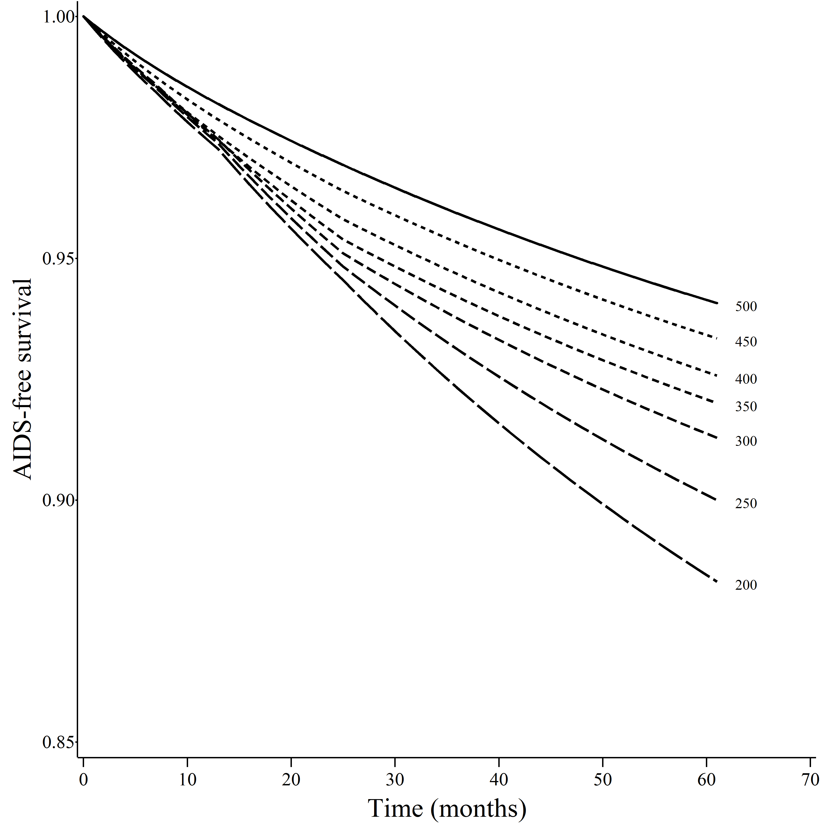
AIDS-free survival

Slide 78
Survival
Regime | Survival, 95% CI |  | Survival Difference, 95% CI
500 | 0.98 | 0.96, 0.99 | 0 (ref.)
350 | 0.98 | 0.97, 0.98 | -0.02% | -1.2, 1.2%
200 | 0.97 | 0.96, 0.98 | 0.50% | -0.9, 1.8%

Slide 79
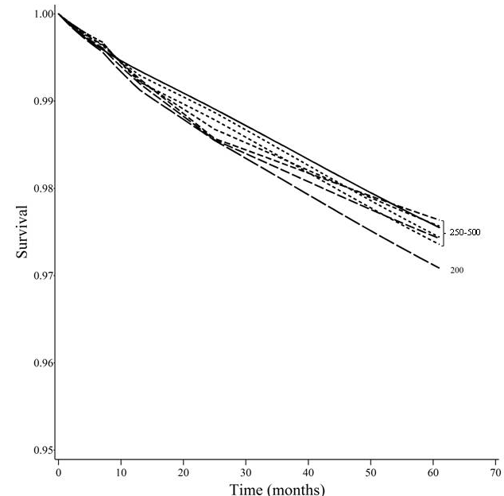
Survival

